Slide 1

Data Findings Report IBM-Data Science- Capstone Module
Smitinjay Srivastava
8th June 2025

Slide 2


Table of Contents
Executive Summary
Introduction
Methodology
Results
Visualization – Charts
Dashboard
Discussion
Findings & Implications
Conclusion
Appendix

Slide 3
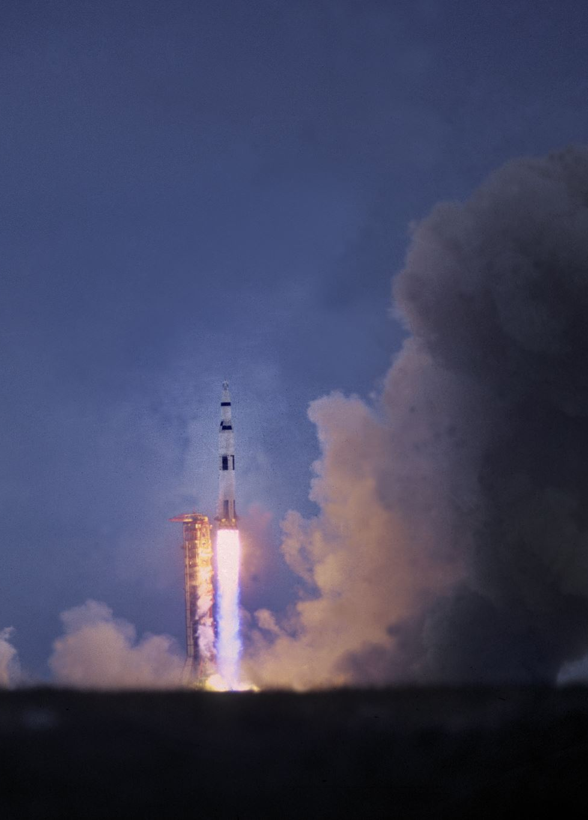
Executive Summary
Examining the rocket company SpaceX and its first-stage rockets, and determining the price of each launch using machine learning algorithms.
Outlines the findings and implications of:
Rocket Testing
Rocket Launch

Slide 4
Data Collection & Wrangling Methodology
Data Collection:
Scraped SpaceX Launch Data using APIs.
Combined with publicly available CSV datasets.
Data Wrangling:
Dropped redundant columns.
Handled missing values.
Created new features (Booster Version Category).
Normalized payload range.

Slide 5
EDA & Interactive Visual Analytics Methodology
EDA:
Used SQL queries for basic exploratory analysis.
Aggregated launch outcomes by site and booster.
Visual Analytics:
Dashboards created using Plotly Dash.
Interactive dropdowns, sliders, and maps.

Slide 6
EDA with Visualization Results
Success Launches Pie Chart:
Visualizes success rates across all launch sites.
Drill-down view for specific sites.
Payload vs. Launch Outcome Scatter Plot:
Payload correlation with success.
Booster version category color-coded.

Slide 7
EDA with SQL Results
SQL Queries Executed:
Total launches per site.
Success vs. failure counts.
Average payload mass per booster category.
Insights:
KSC LC-39A has the highest success rate.
Heavy boosters correlate with heavier payloads.

Slide 8
Interactive Map with Folium Results
Mapped launch sites with Folium.
Color-coded markers for successful vs. failed launches.
Distance measurements from launch sites to nearby coastlines.

Slide 9

Predictive Analysis Methodolgy

Slide 10
Predictive Analysis Methodolgy
Logistic Regression Model.
Input Features: Payload Mass, Booster Version Category, Launch Site.
Target: Launch success (binary classification).
Standardized features using Scikit-learn.

Slide 11
Predictive Analysis Results
Accuracy:
Train accuracy: ~85%
Test accuracy: ~82%
Confusion Matrix:
High true positive rate.
Few false negatives (missed successes).

Slide 12
Plotly Dashboard: SpaceX_Dashboard Results
KSC LC 39A had both the largest number of successful launches (76.9% of successful launches) and the highest launch success rate in total (41.7%).
The payload range that had the highest successful launch rate was 1,1225 to 6,225 range
The payload range that had the lowest successful launch rate was the 7,500 to 10,000 range
The F9 booster version that had the highest launch success rate was the FT with 14 successful ranges across the entire payload range.

Slide 13
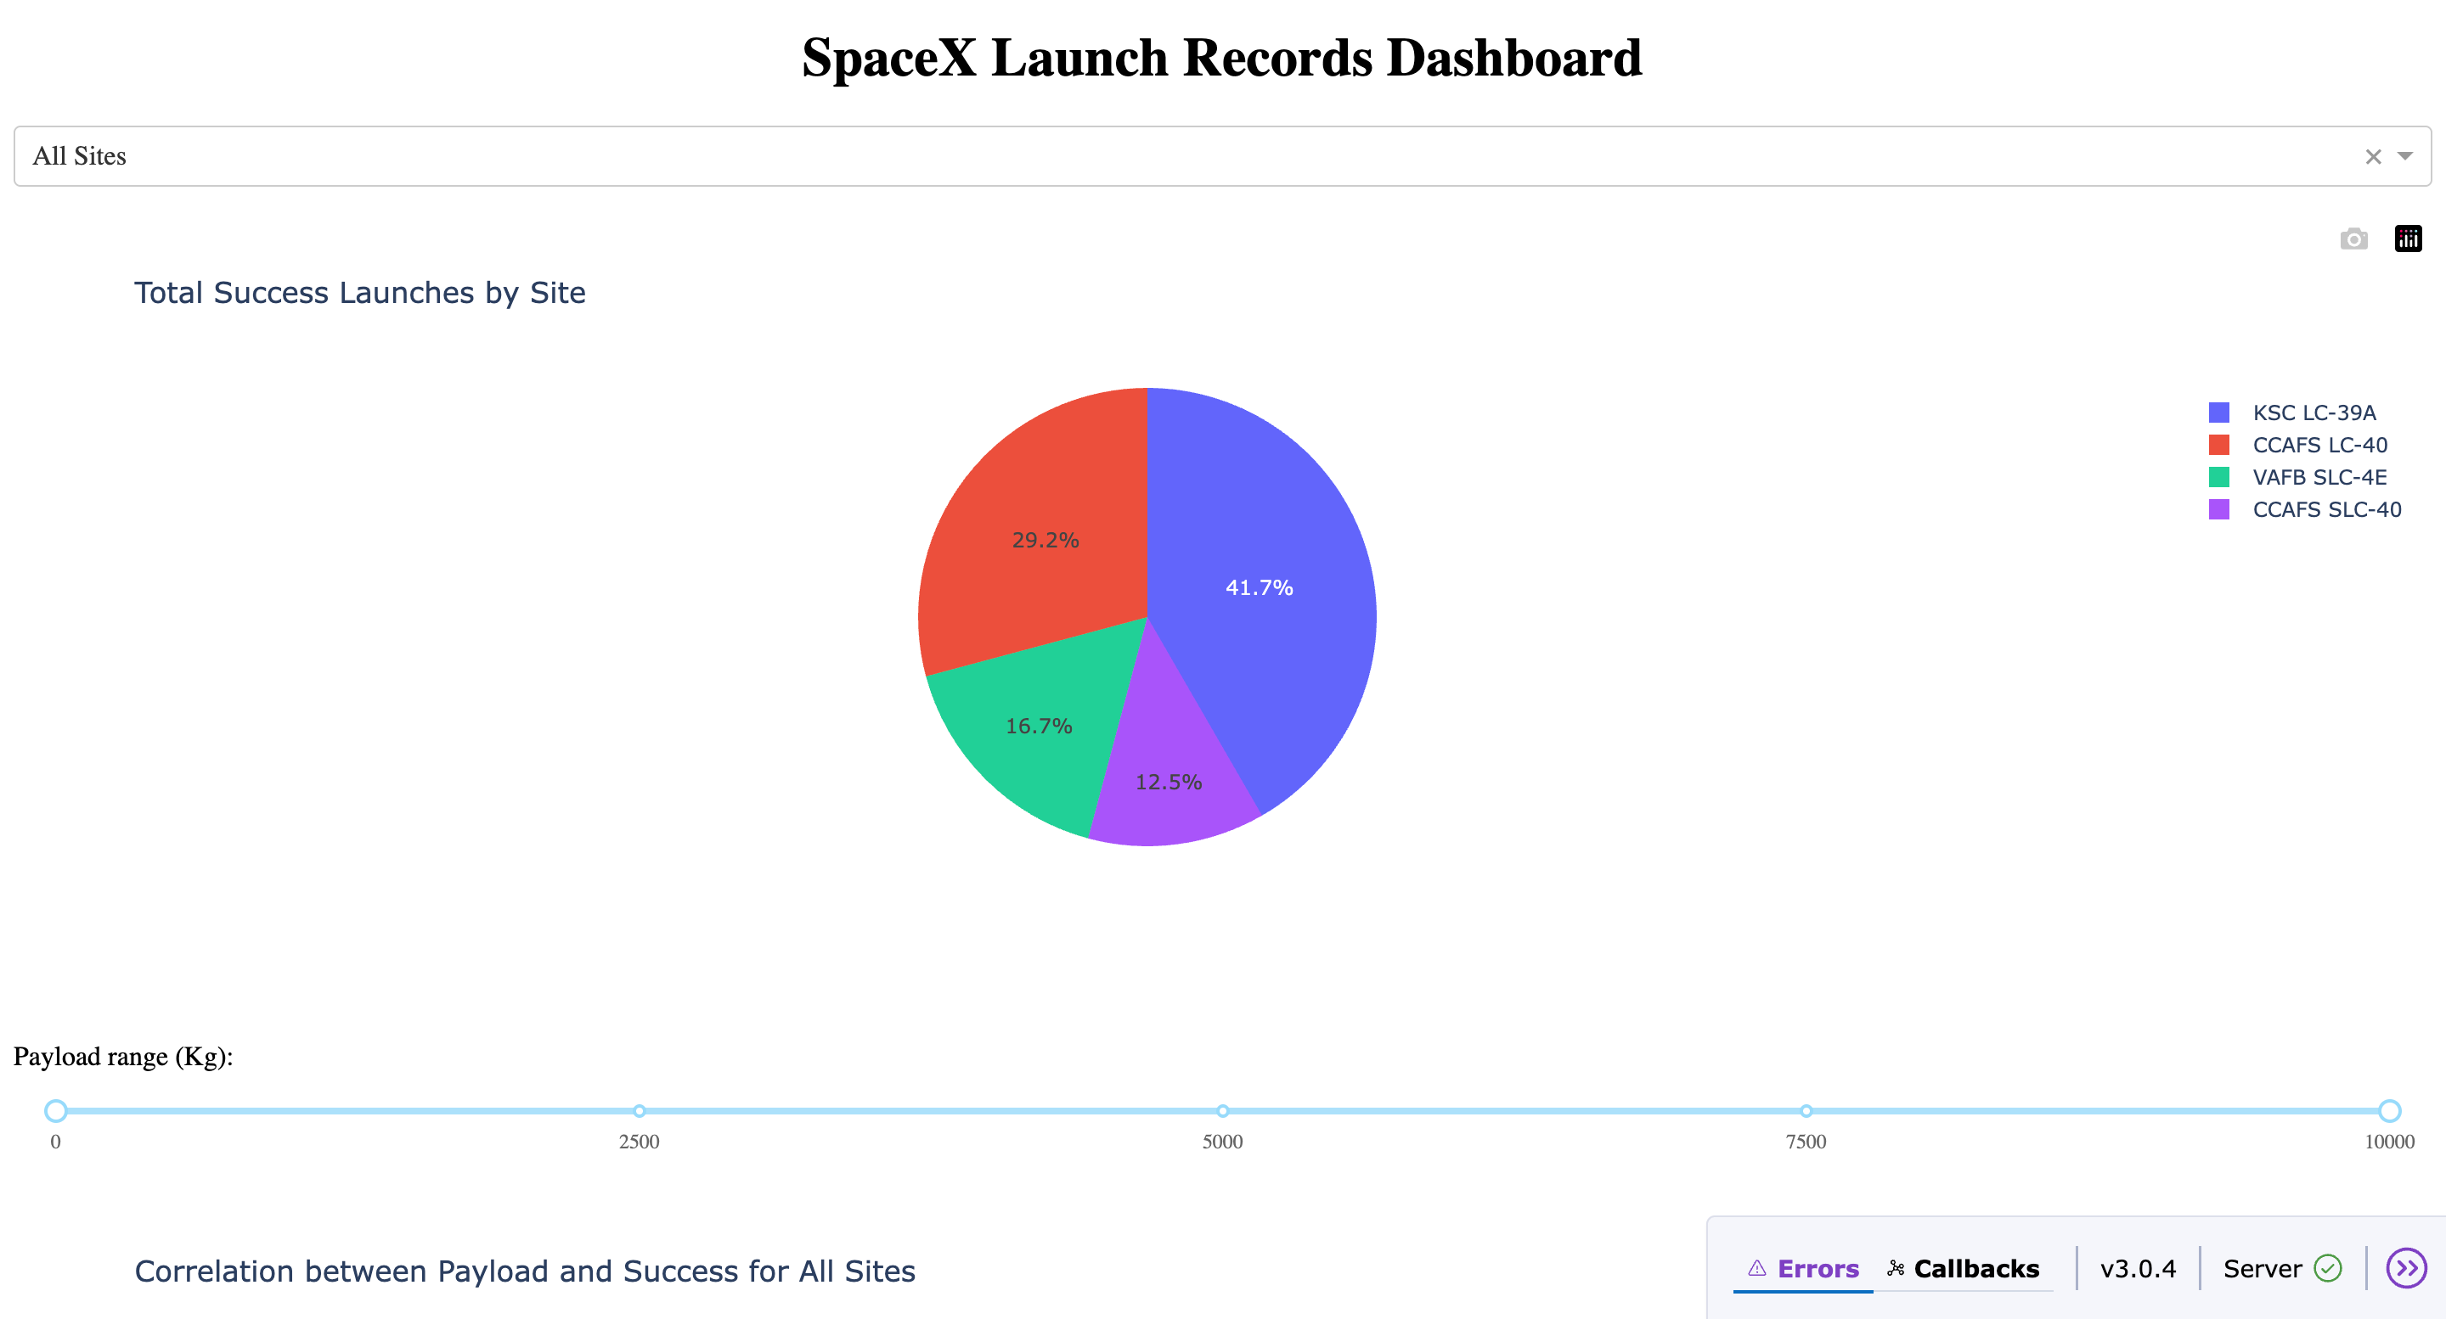

Slide 14

Conclusion
Launch site and booster type are significant predictors of success.
Payload mass shows a mild correlation with success.
An interactive dashboard provides easy access to insights.
Future Work: Include weather data, expand booster version details.

